Slide 1
Model Based Design Workshop
Mark Walker
Sylvain Sauvage

Slide 2
Agenda
Overview of Simulink for DO-178
User examples
Workshop structure introduction
Simulink Projects
DO-178 Qualification Kit
Software Development Process
Verification of Requirements Process
Verification of Design Process
Verification of Coding and Integration Process
Testing of Integration Process
Verification of Verification Process Results

Slide 3
Overview of MathWorks Tool Chain R2012b Example of DO-178 Software life-cycle
xPC TargetTM
Simulink® CoderTM
Simulink®
Stateflow®
Simulink® Design VerifierTM
Requirements
Simulink®
Simulink® Design VerifierTM
Simulink® Validation
VerificationTM (RMI)
Stateflow®
Simulink® Validation VerificationTM (MC)
Embedded CoderTM (PIL)
SystemTestTM
Simulink® Report GeneratorTM (SDD)
Simulink® Validation
VerificationTM (MA)
Polyspace® ( RTE)
Models
Code coverage
Simulink® Code InspectorTM
Embedded CoderTM (PIL)
Embedded CoderTM
Simulink® Code InspectorTM
SystemTestTM
Polyspace® (MISRA, RTE)
Polyspace® ( RTE)
Validate
C code
Verify
Trace
Compile & Build
Abbreviations
DV: Simulink Design Verifier
MA: Model Advisor
MC: Model Coverage
RMI: Requirements Management Interface
RTE: Run-Time Error
PIL: Processor-in-the-Loop
SDD: System Design Description
VV: Verification and Validation
Develop
DO Qualification Kit
EOC

Slide 4
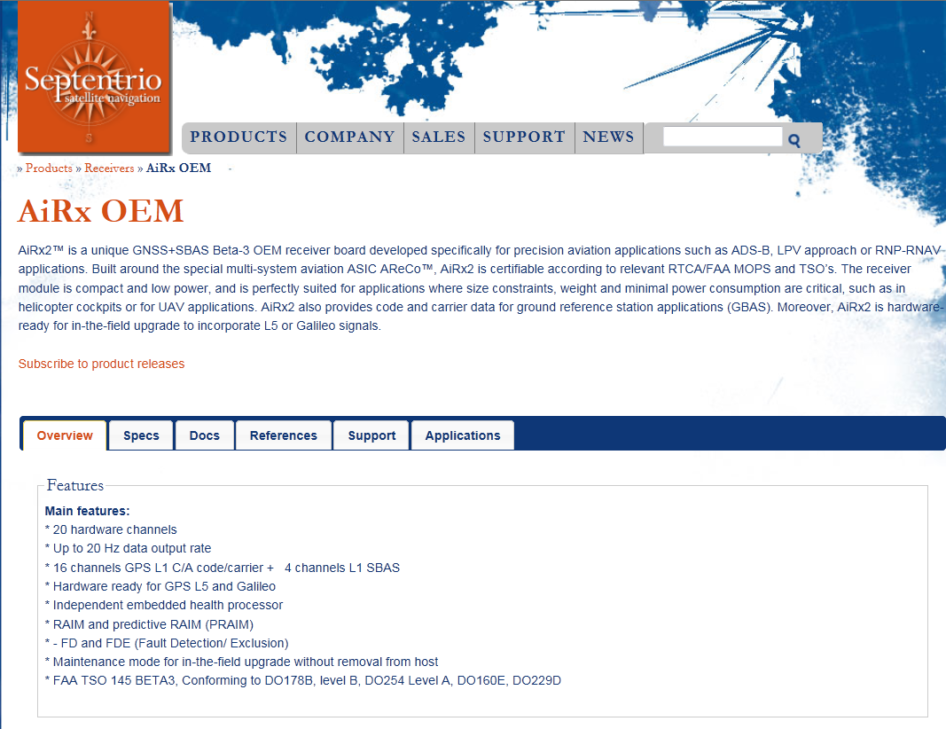
Septentrio
http://www.mathworks.com/tagteam/72275_92004v00_developing-high-integrity-aircraft-approach-systems.pdf

Slide 5
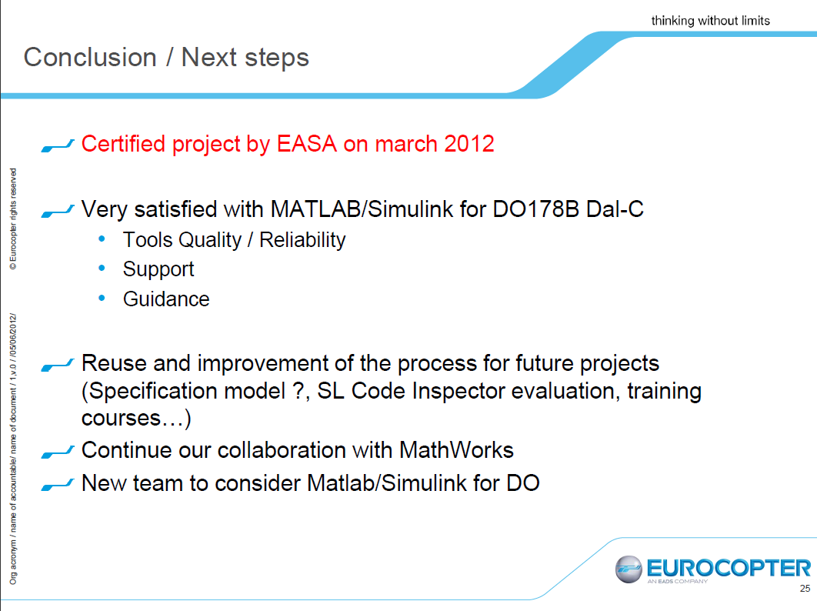
Eurocopter – EASA – New in 2012

Slide 6


BAE Utilizes Simulink HDL Coder for DO-254 Level A Project – New in 2012
Challenge
Develop and deploy a control law to an FPGA that can be certified to DO-254 Level A for a commercial business jet.
Solution
Develop control laws in Simulink, link requirements to blocks using Simulink Verification and Validation, and generate HDL code using Simulink HDL Coder.
Results
Simulink models are used to develop and verify designs, and generate HDL code.
Generated code is platform independent, readable, and efficient.
Traceability established between requirements, detailed design expressed in Simulink, and HDL implemented for DO-254 Level A certification.
“Simulink HDL Coder generates readable code that is traceable to the requirements and is critical to our DO-254 Level A certification plans.”
Mike Weaver
Senior Systems Engineer

Slide 7
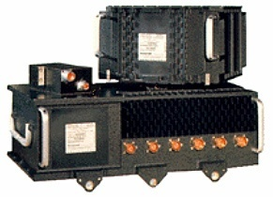

Design Times at Honeywell Cut by 60%
Challenge
Update a flight control system while reducing development time and costs
Solution
Use design tools from MathWorks to enable one team to design, model, and simulate the flight-control laws and automatically generate flight-ready code
Results
A five-to-one improvement in productivity
Highly accurate, reusable code
A superior product
“[Using Simulink and Simulink Coder] we found we could do in half a day what previously took a week or more… It is pretty easy to see at least five-to-one improvement over the way we used to work.”
Wayne King
Honeywell Commercial Aviation Systems

Slide 8
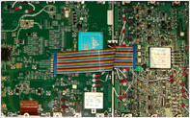


Fairchild Controls Uses Real-Time Workshop Embedded Coder to Generate Flight Code Certified to DO-178B
Challenge
Develop Global Tanker Motor Drive Unit for Boeing 767 in a way that improves quality but reduces costs
Solution
Use Simulink to design the software and detect errors very early in process, then generate flight code automatically
Results
DO-178B certification achieved
Generated code ran fast, well within required cycle time
Device driver code from Target Support Package used in the DO-178B certified application software
Shorter development time
More maintainable product
40 kW motor drive unit developed using Simulink (read about it here)
“Automatic code generation is entrenched in our in DO-178B processes. We are excited by the new DO Qualification Kits and MathWorks DO-178C efforts.”
Dr. Haik Biglari, P.E. Senior Director of Engineering Fairchild Controls

Slide 9
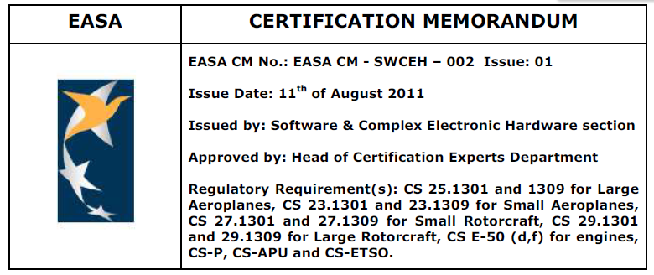
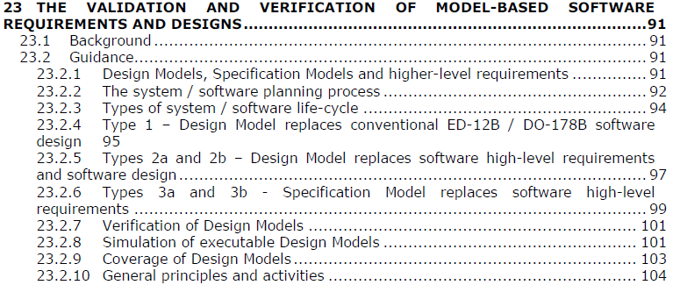
Development of airborne systems Model-Based Design & Certifications
MBD recognized as an efficient approach for developing safety-critical applications
MBD objectives and activities are now better defined (Full definition in DO-178C / DO-331, but you can download this for free)
EASA identifies MATLAB/Simulink as an MBD tool for DO-178B

Slide 10
Models as High and Low Level Requirements?
DO-178C approach explained by Pierre Lionne at MathWorks Model-Based Design conference for High-Integrity systems (Nov 2011)

Slide 11
Verification Process
Test (classical)
High Level
Requirements
Low Level
Requirements
Executable Object Code
Notes:
Main idea is to verify the EOC by performing tests against 2 diferent levels of abstraction of requirements.

Slide 12
Verification Process
Test (example #1)
Model = HLR
Low Level
Requirements
Executable Object Code

Slide 13
Verification Process
Test (example #2)
High Level
Requirements
Model = LLR
Executable Object Code

Slide 14
Verification Process
Test (example #3)
?
Model = HLR + LLR
Executable Object Code
Notes:
In this case we only have one level of abstraction requirements not any more possible…

Slide 15
Verification Process
Test (example 3)
Model Parent
Requirements
Model = HLR + LLR
Executable Object Code
Notes:
This approach is applicable where ever the model and the Model Parent requirements are (system area or SW area)
Remark: Model Parent Requirements is not the terms used in the supplement but this one is more concise and I believe very wel understandable.

Slide 16
Verification Process
Test (example 3)
When model express both LLR and HLR, it is required to show:
Compliance & Robustness of EOC with Model
Compliance & Robustness of EOC with Model Parent Requirements (whatever the process that produced it)

Slide 17
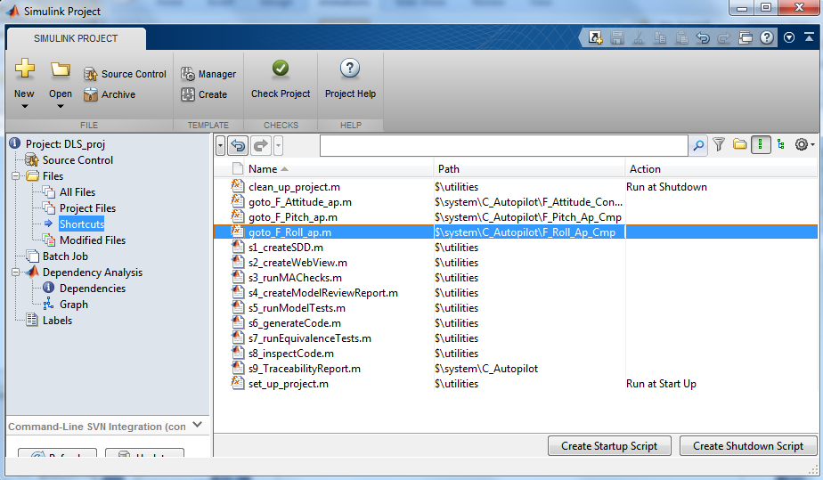
Simulink Projects

Slide 18
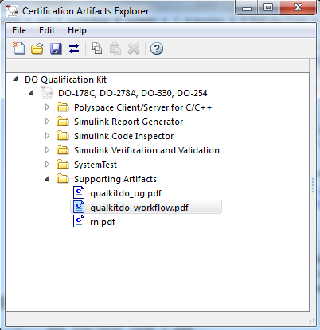
DO Qualification Kit

Slide 19
What does the Qualification Kit do?
DO178
Qualification Kit Workflow
Workflow for Using MBD and The MathWorks tools
Defines the usage of tools for each DO178 objective.
Help qualify the following tools:
Simulink Verification and Validation
Simulink Report Generator
Simulink Code Inspector
System Test
Polyspace
By providing
Operation requirements for the tools above.
Test plan and test suite to demonstrate the tool compliance.
Reference execution of all tests
Qualify tools
For each tool
TOR: Tool Operational Requirements
Details requirement for a tool
Plan
Verify
TQP: Tool Qualification Plan
How to execute the tests.
TCPR: Test Cases, Procedures and Results
Qualkitdo<tool>RunTests.xlsx
Tests/modelnnn.slx
Tests/modelnnn.slx
Qualkitdo<tool>RunTests.rpt
Tests/modelnnn.slx
Tests/modelnnn.slx
Qualkitdo<tool>RunTests.m
Compare and Report
Outputs/modelnnn/
Reports
Generated code

Slide 20
DO-178C Structure TBD
DO-178C 1.0
Introduction
DO-178C 2.0
System Aspects relating to Software Development
Software Life Cycle
DO-178C 4.0
DO-178C 5.0
DO-178C 6.0
DO-178C 7.0
Software Planning Process
Software Development Process
Software Verification Process
Software Configuration Management Process
DO-178C 8.0
DO-178C 9.0
DO-178C 10.0
Software Quality Assurance Process
Certification Liaison Process
Overview of Certification Process
DO-178C 3.0
DO-178C 11.0
Software Life Cycle Data
DO-178C 12.0
Additional Considerations
Model-Based Design
Early verification and validation
Code generation
Tool classification and qualification
Notes:
DO-178C dash 6 is concerned with software development processes and includes information on the usage of MBD, early V&V (such as testing at the model level) and PCG
Part 8 is covers among other supporting processes tool qualification topics

Slide 21
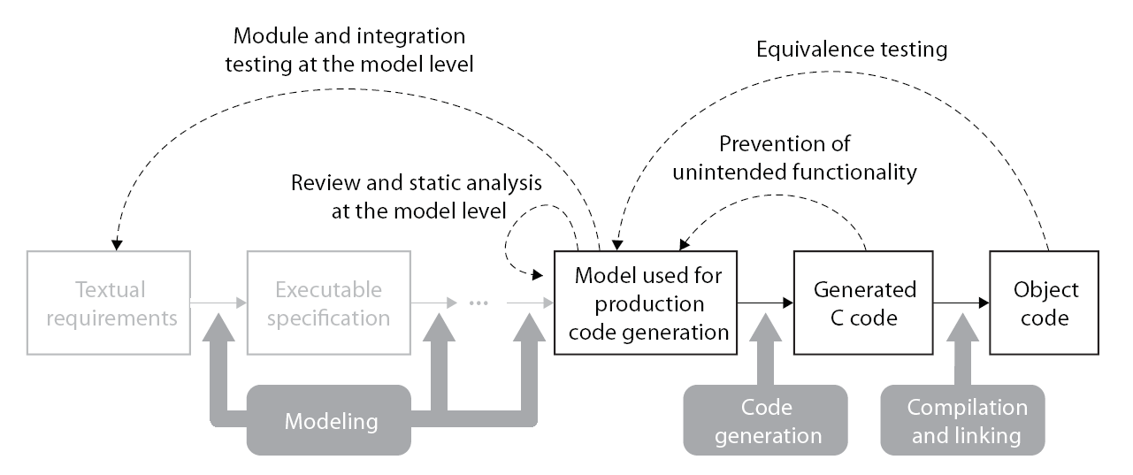
TBC DO-178C Reference Workflow Verification and Validation of Models and Generated Code
Model Verification
Code Verification
Discover design errors at design time
Gain confidence in the generated code
Notes:
- Tool Chain example (not all steps/tools are mandatory)
- Integrated tool chain, covering both Software development as well as verification and validation)

Slide 22

DO-178C Reference Workflow Example Tool Chain
MathWorks provides an integrated tool chain for DO-178C
TBD
Model Advisor (SLVnV),
Property proving (SLDV)
PIL testing / CGV (Embedded Coder), Test generation (SLDV)
Traceability report (Embedded Coder), Traceability matrix generation (IEC Cert Kit),
Bullseye code coverage integration (Embedded Coder)
Simulink, Model coverage (SLVnV),
Requirements Management Interface (SLVnV)
Simulink, Stateflow, Simulink Fixed Point
Embedded Coder
Notes:
- Tool Chain example (not all steps/tools are mandatory)
- Integrated tool chain, covering both Software development as well as verification and validation)

Slide 23
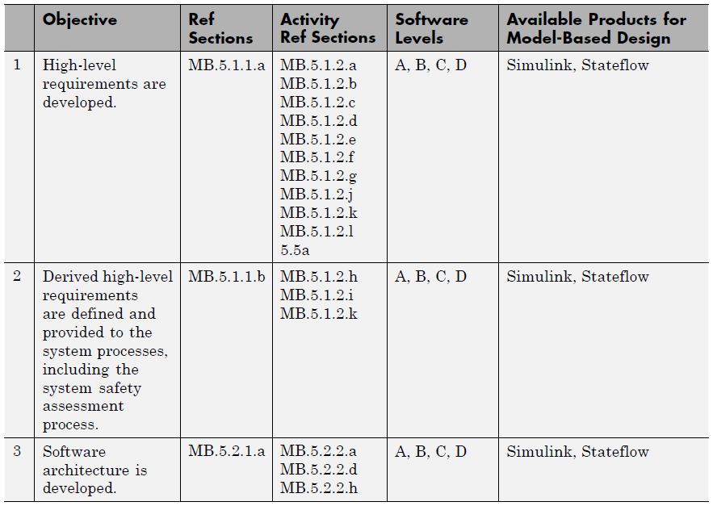
Software Development Process (1)
Model used for high level requirements or parent requirements linked to model
Defined by “derived requirement” link.
Model Reference hierarchy defines software architecture

Slide 24
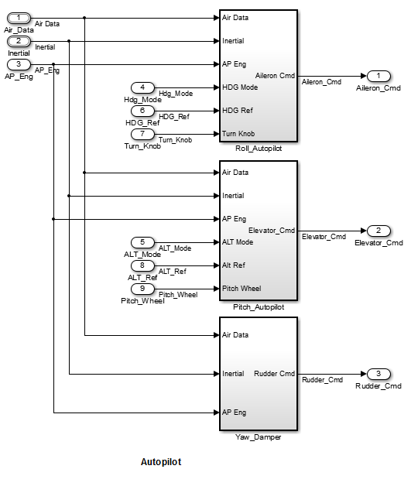
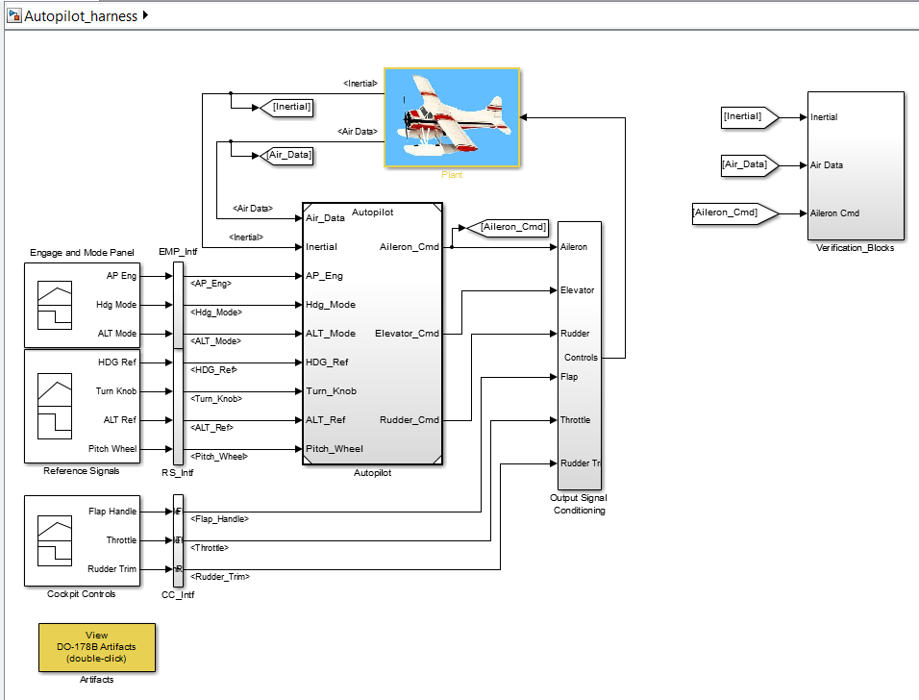
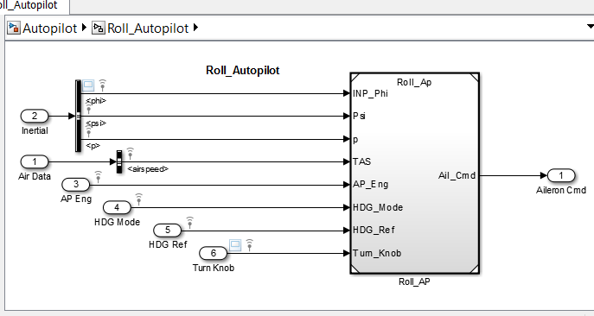
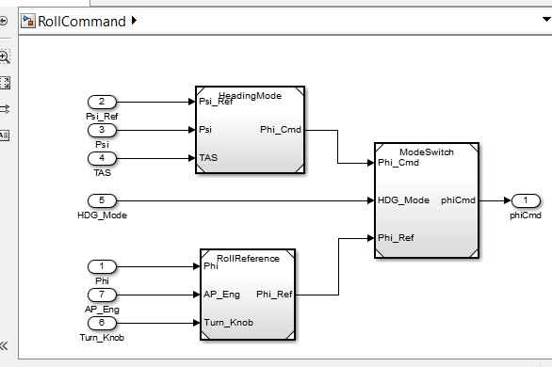
Model Development

Slide 25
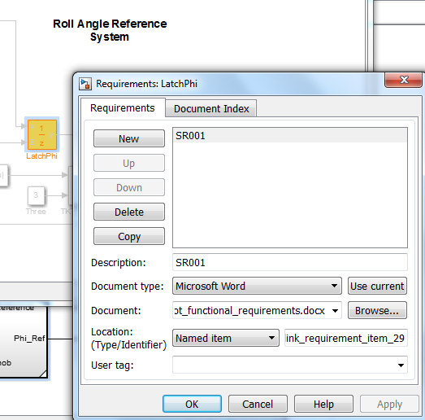
Requirements Linking

Slide 26
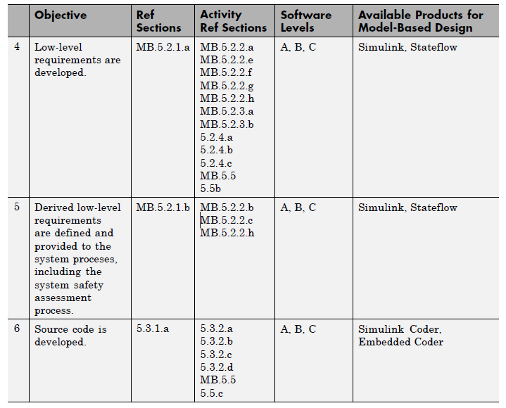
Software Development Process (2)
Developed as a Simulink model
S1: System Design Description Report
S6: Generate Code

Slide 27
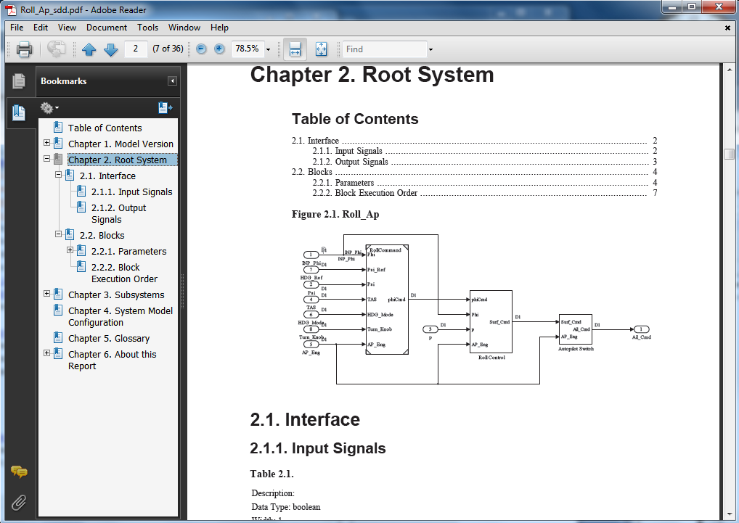
System Design Description Report

Slide 28

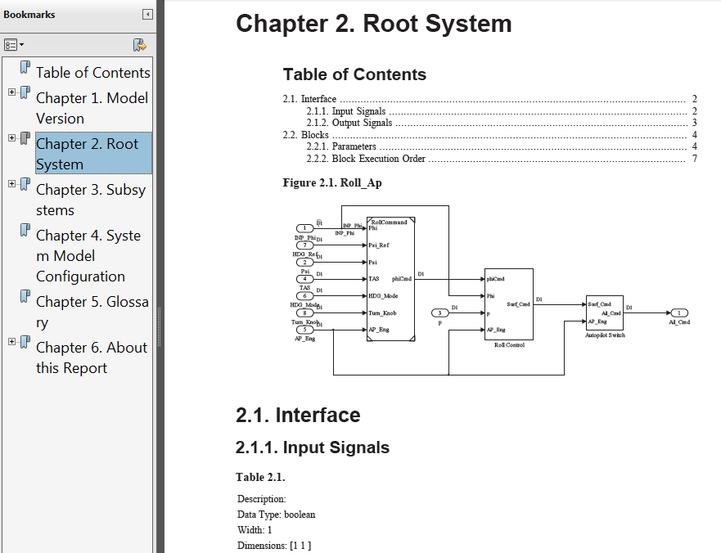


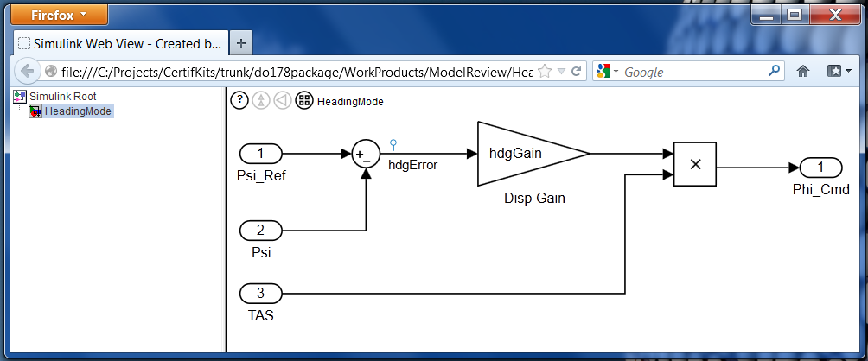
Web View

Slide 29
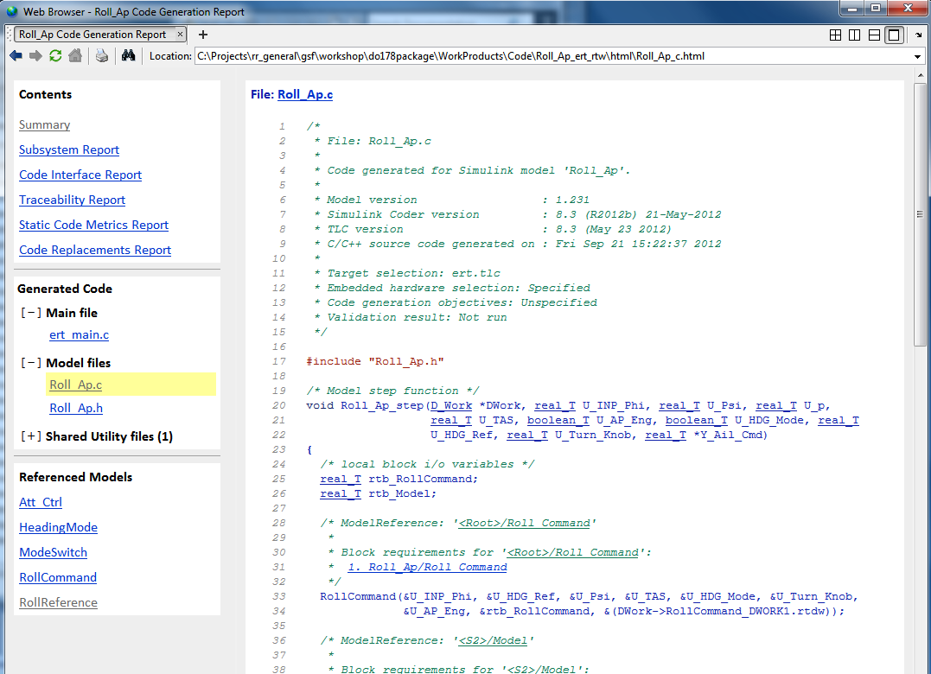
Generated Code

Slide 30
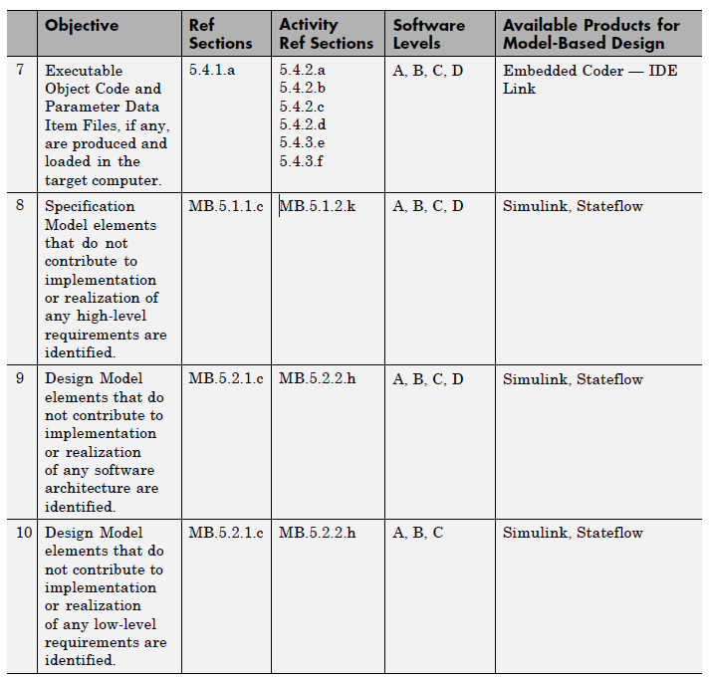
Software Development Process (3)
Compilation triggered from Embedded Coder build
S9: Traceability report
S8: Simulink Code Inspector traceability report
As above
As above

Slide 31
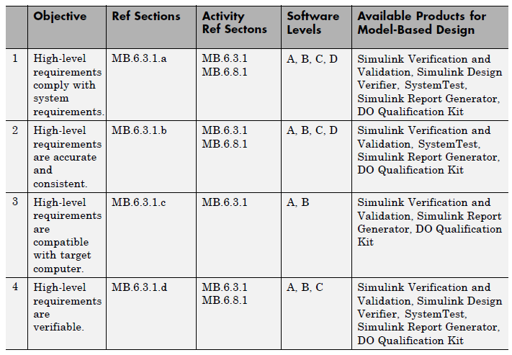
Verification of Requirements Process (1)
S1: System design description
S4: Model tests (includes coverage)
As above
As above
As above (SLDV also helps identify unreachable requirements)

Slide 32
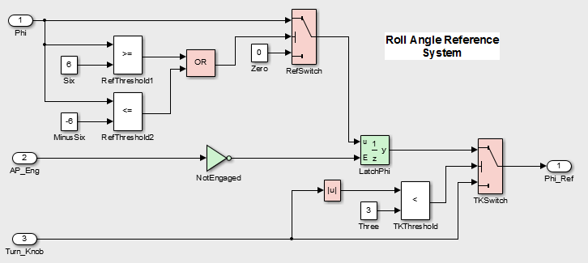
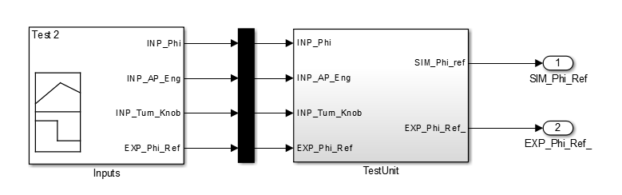
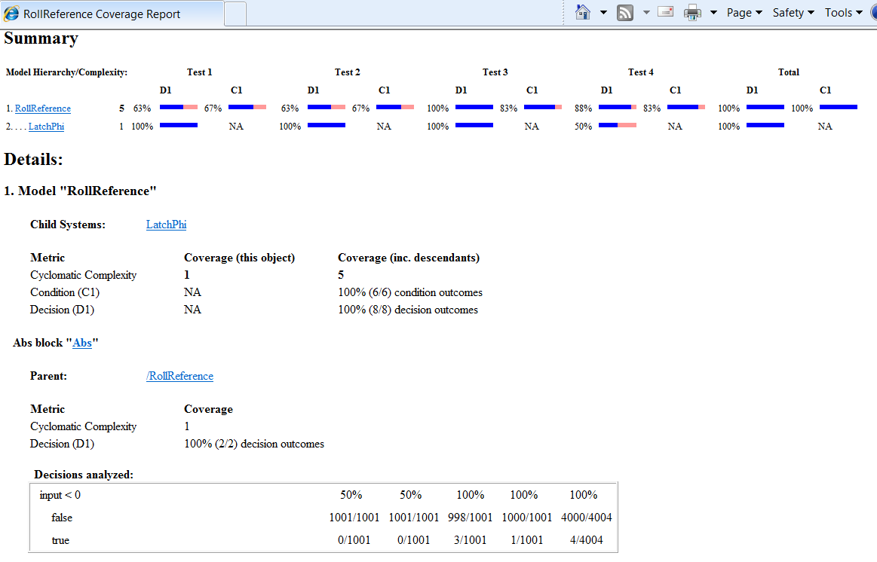
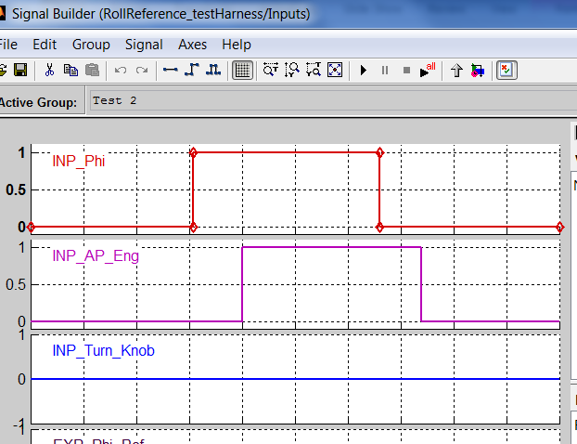
Coverage Reports
2
1

Slide 33
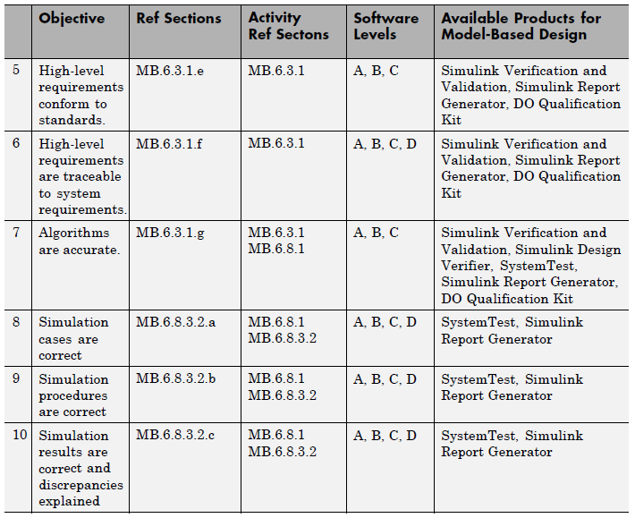
Verification of Requirements Process (2)
S3: Model advisor checks
S9: Traceability report
S5: Model tests
S9: Traceability report
As above
As above
As above

Slide 34
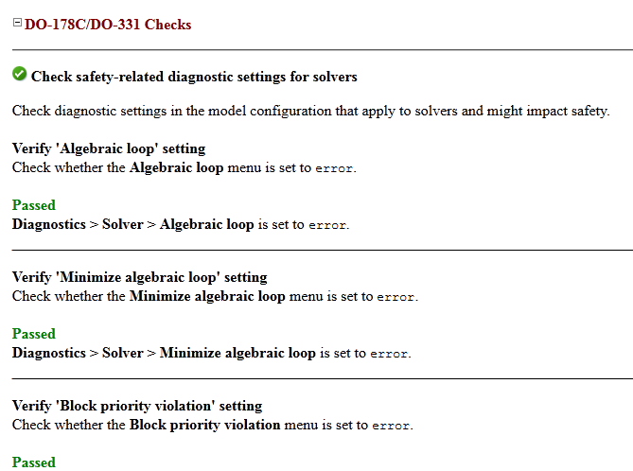
Model Advisor Checks

Slide 35
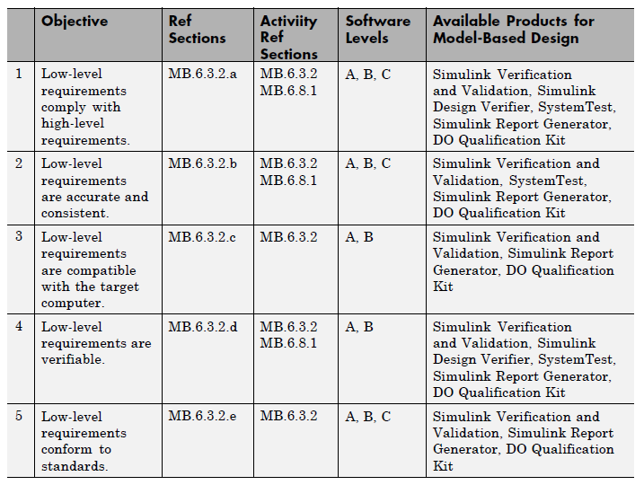
Verification of Design Process (1)
S1: SDD
S4: Model review
Model analysis
S5: Simulation
S3: Model Advisor
S5: Use per-component test cases
S1: SDD
S3: Model Advisor
S5 Model tests
S1: Report
S3: Model Advisor

Slide 36
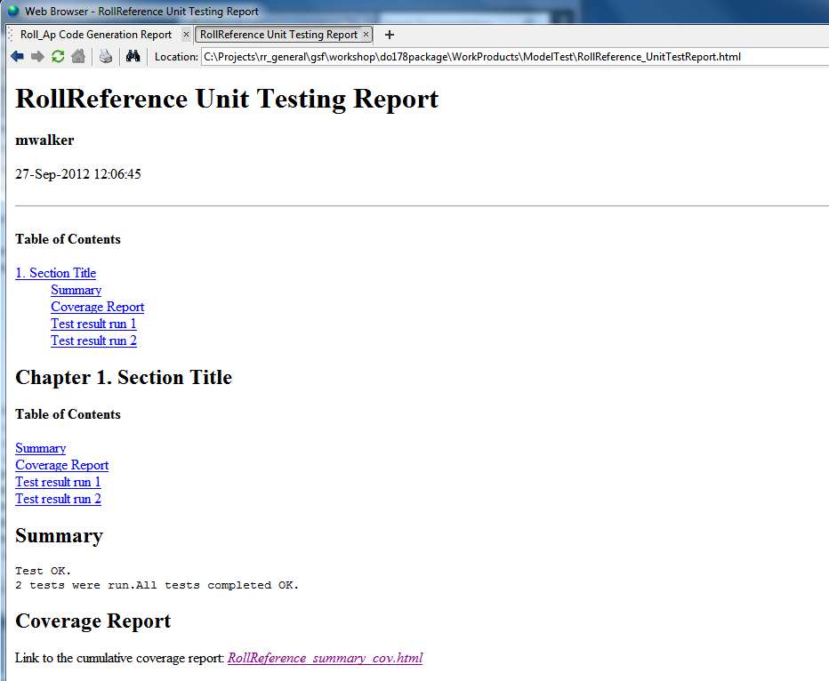
Execute Model Simulation

Slide 37
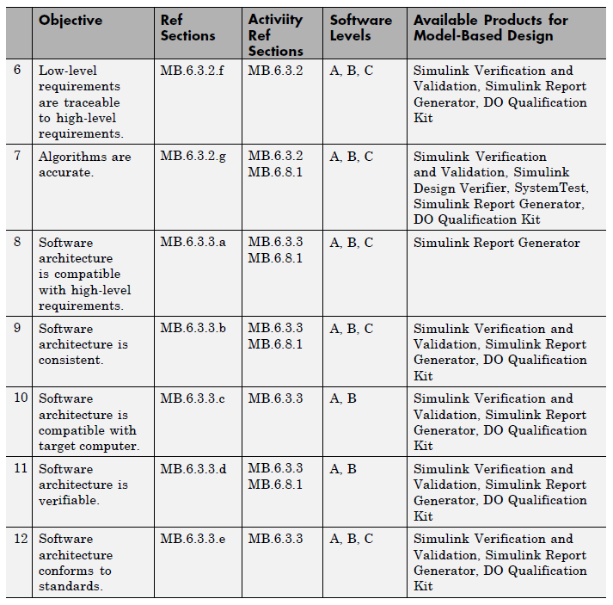
Verification of Design Process (2)
S9: Review traceability reports
S5, S7:Review test execution reports
S1: Generate SDD,
Dependency viewer
S1: Generate SDD
S1: Generate SDD,
S3: Advisor
S7: Run equivalence tests
S3, DO-178 and MAB checks

Slide 38
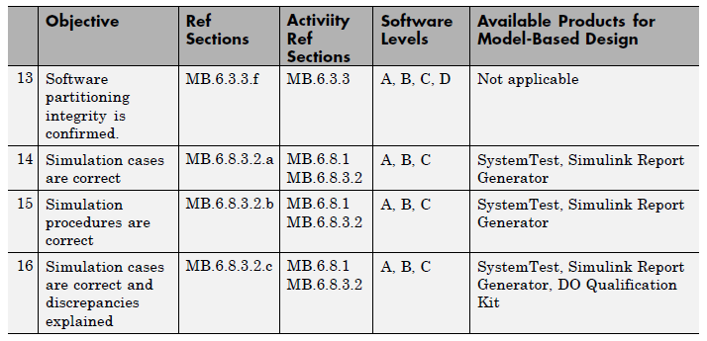
Verification of Design Process (3)
Review test cases
S5, S7:Review test execution reports
S5, S7:Review test execution reports

Slide 39
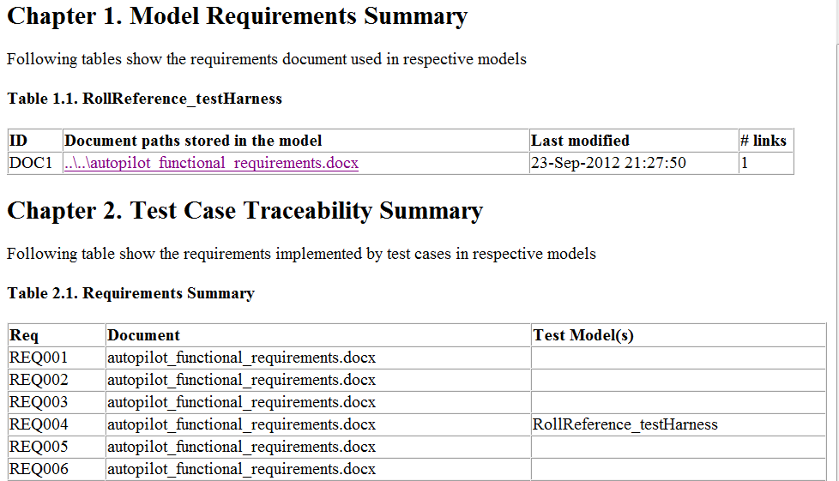
Traceability Report
Tools and Formats:
Word, Excel, DOORS, MuPAD
text, html, pdf, URL

Slide 40
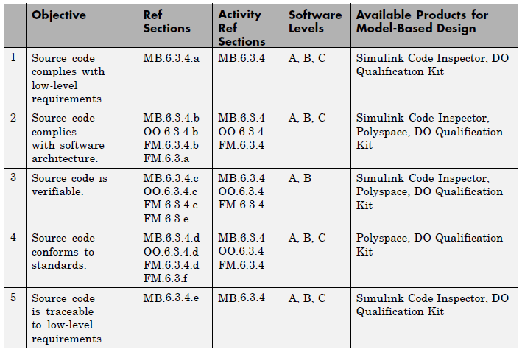
Verification of Coding and Integration Process (1)
S8: Code inspector
S8: Code inspector,
Polyspace
As above
Polyspace (not shown in workshop)
S8 Code Inspector.

Slide 41

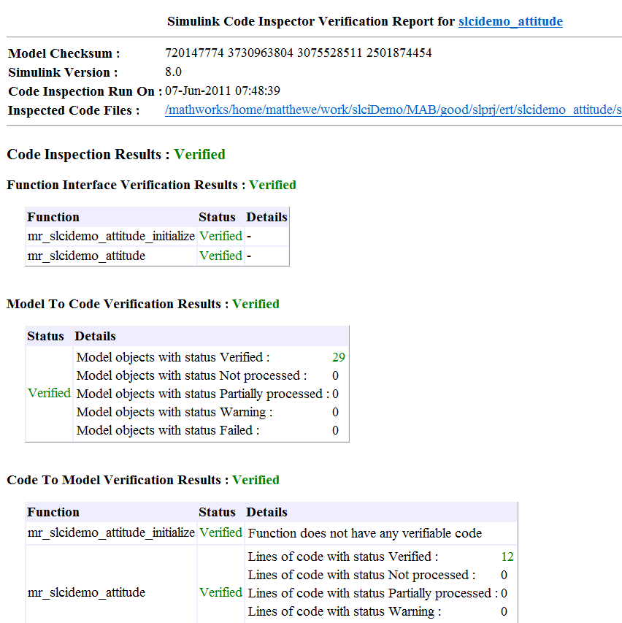
Measure Equivalence vs. Implementation
Code
verification
Independently verify that Embedded Coder generated code traces to and complies with low-level requirements
Demonstrate that model and source code match structurally and functionally
Provide model ⬄code traceability data
Eliminate/reduce manual code reviews for DO-178 software
Same certification credits as qualified code generator
Model
Source code
Embedded Coder
Code traceability
Notes:
Must be suitable for customers as the slide will be made available for external use at the time of release.
Motivation
One or two sentences describing the problem in terms of how customers phrased or think of the issue. Consider both the feature and the workflow motivations.
Solution (Added Details)
More details as appropriate. How does it integrate with other features and products?
Doc Reference
In addition to release notes, which should be the source for most of the information on this slide. Add a doc reference if possible.
Demo
Shipping demo name
Limitations, Known Problems, and Workarounds
What are the current limitations? Are there problems end users are likely to run into? Are there Workarounds? Is anything likely to break, not just feature or product but interoperability with other products?
Questions and Debugging Tips (for MathWorks Support team)
What questions might end users ask?
What should Support try out when end users run into problems?
Are there any debugging tips or processes Support should follow?
Release Number – Tech Marketing to add icon closer to release date.

Slide 42
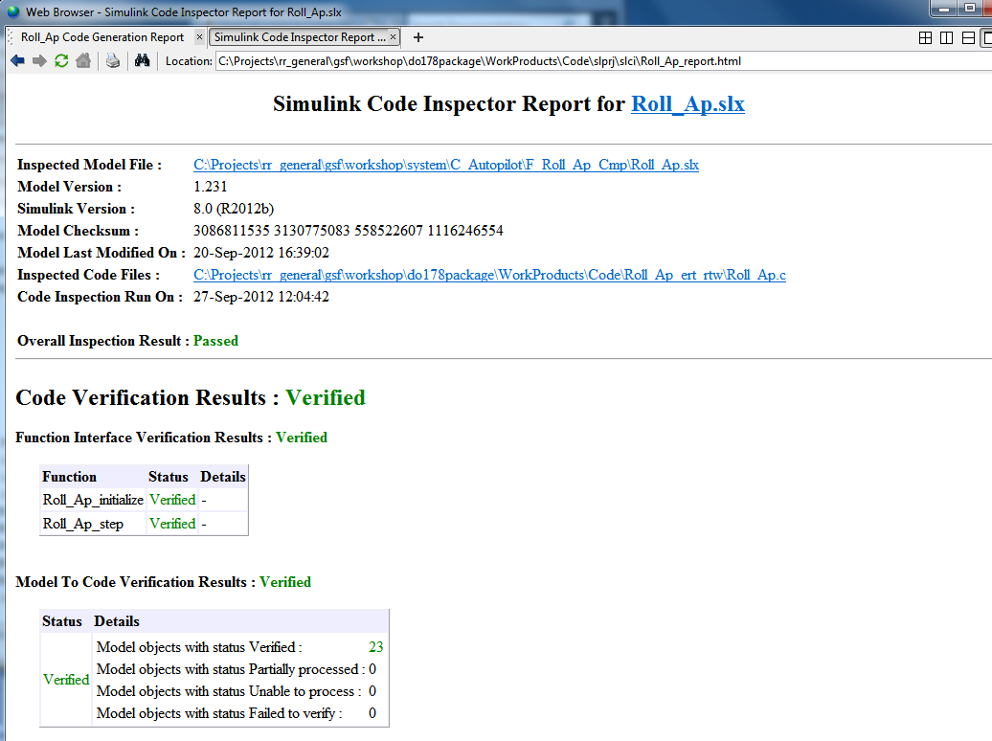
Simulink Code Inspector

Slide 43
Simulink Code Inspector
Will accept:
Renaming, Reordering of local variables
Swapping independent lines of code
Swapping ‘+’ or ‘*’ operands
New or deleted comments
Will accept and warn:
Introducing extra local variables and splitting a line of code using them
Transform ‘3.0’ to ‘(2.0+1.0)’
Adding harmless lines ‘u=u+0.0;’
Will not validate
True changes
Deleted code
Added code
Constant values
Operators
Incorrect type cast
Operands
Out of order execution
Syntax errors (e.g. remove ‘{’ or ‘;’)
Negating a condition and swapping if and else clauses
Changes in local variables’ scope
Replace ‘if(a)’ by ‘if(a!=0)’

Slide 44
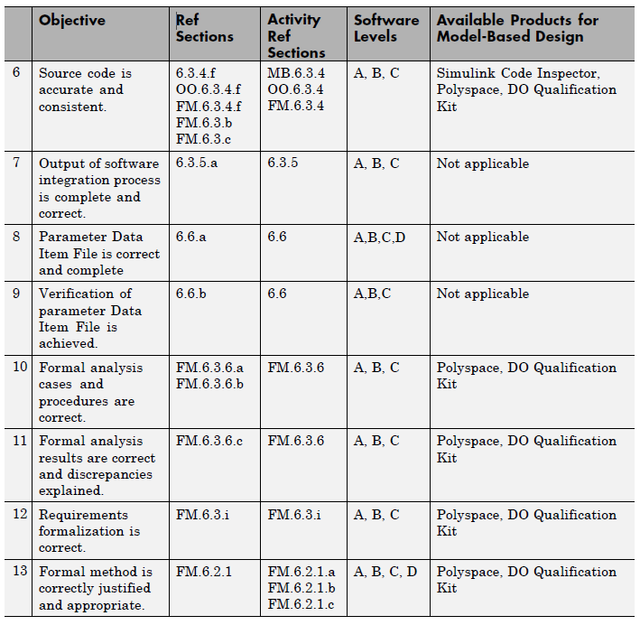
Verification of Coding and Integrating Process (2)
S8: Code Inspector, Polyspace
Polyspace (not shown in workshop)
As above
As above
As above

Slide 45
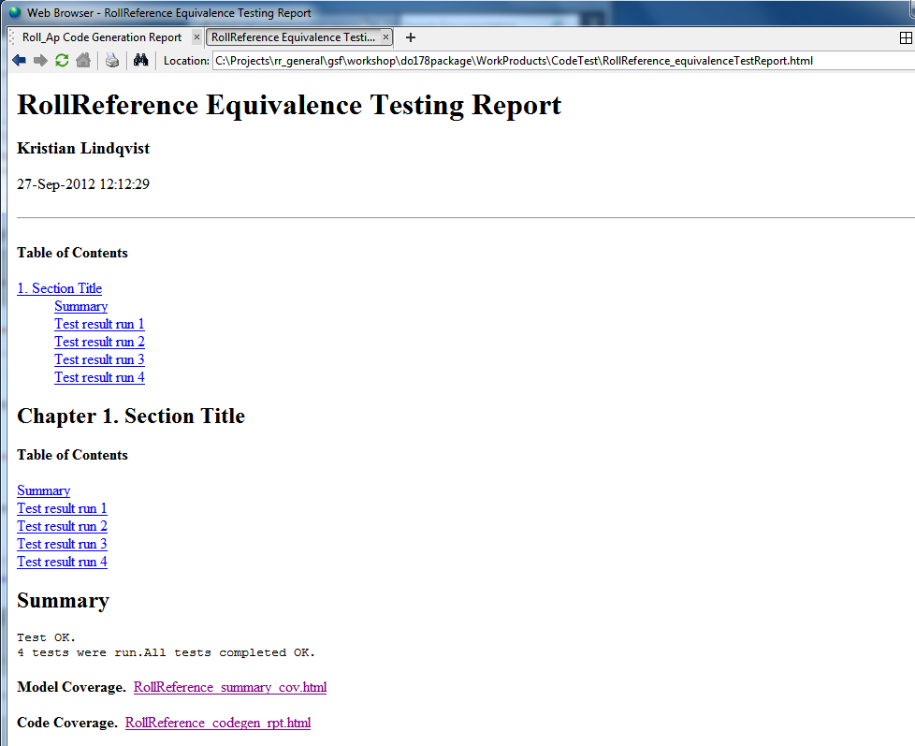
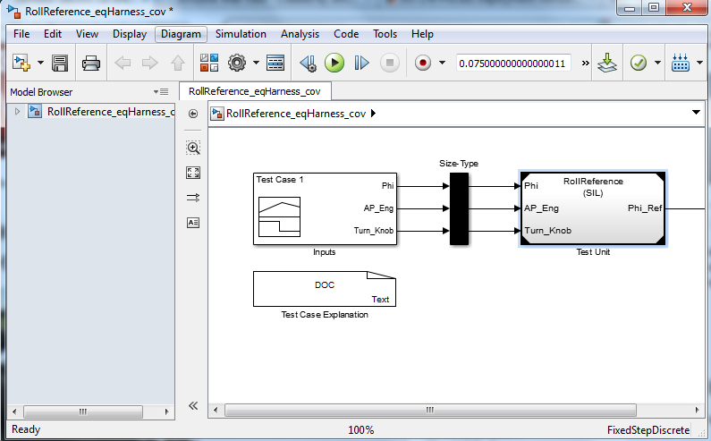
EOC Equivalence Tests

Slide 46
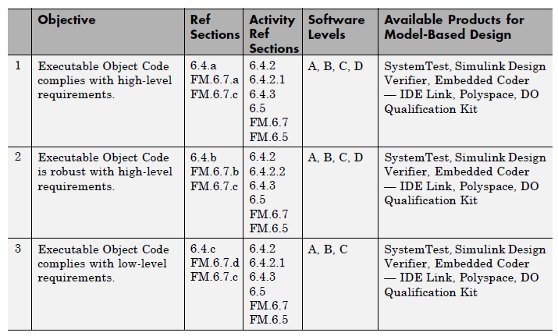
Testing of Integration Process (1)
S7: As per S7 but PIL not SIL mode
As above
As above

Slide 47
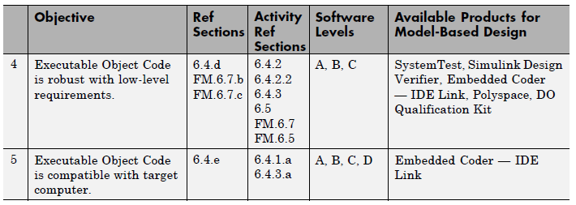
Testing of Integration Process (2)
As above
As above

Slide 48
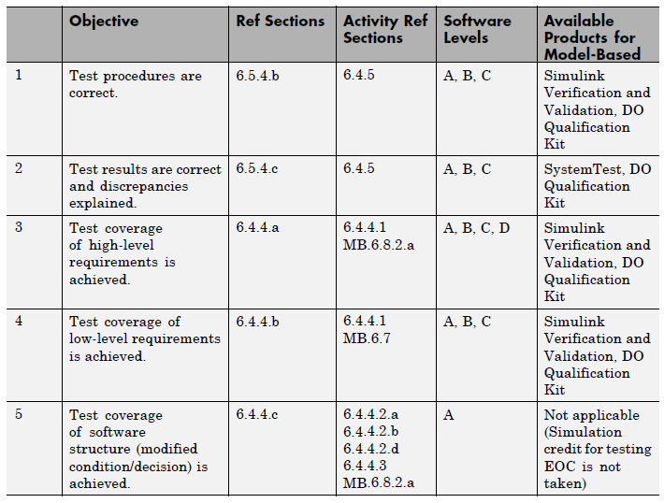
Verification of Verification Process Results (1)
S5 and S7 reports
Not included
S5 and S7 reports
As above

Slide 49
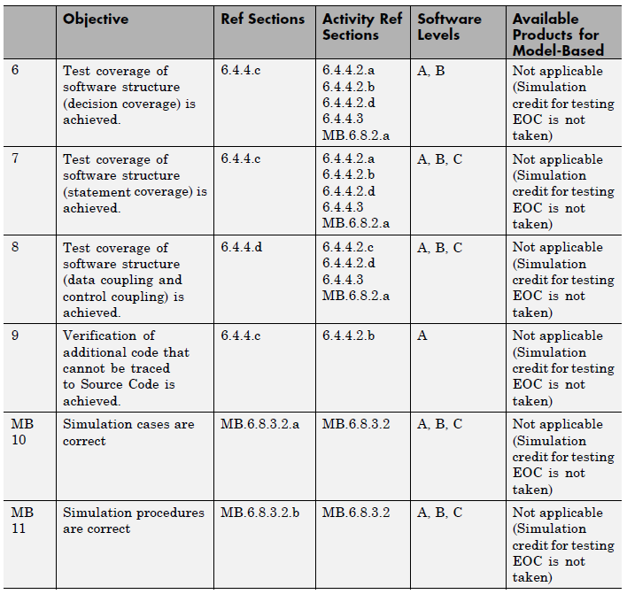
Verification of Verification Process Results (2)

Slide 50
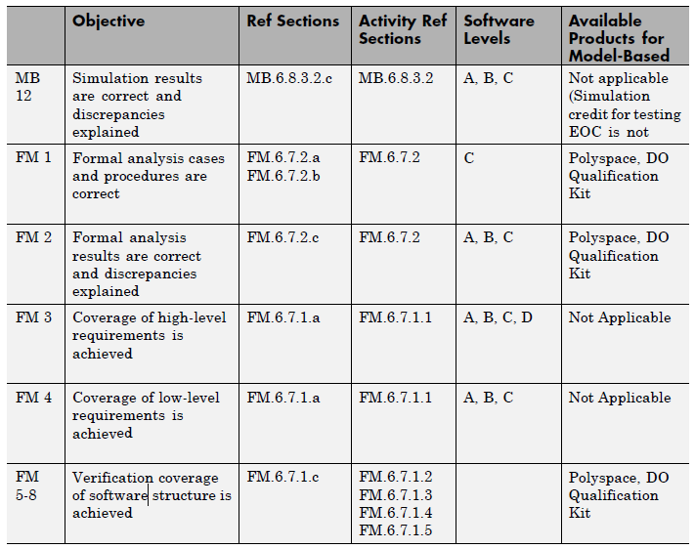
Verification of Verification Process Results (3)
Not shown in workshop
As above
As above

Slide 51
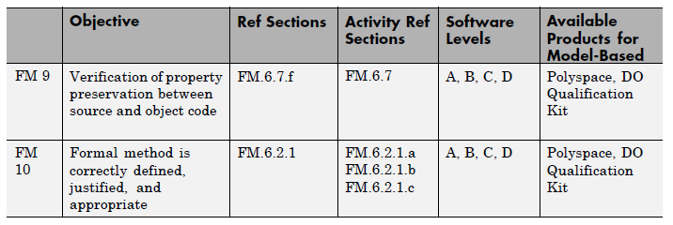
Verification of Verification Process Results (4)
As above
As above

Slide 52
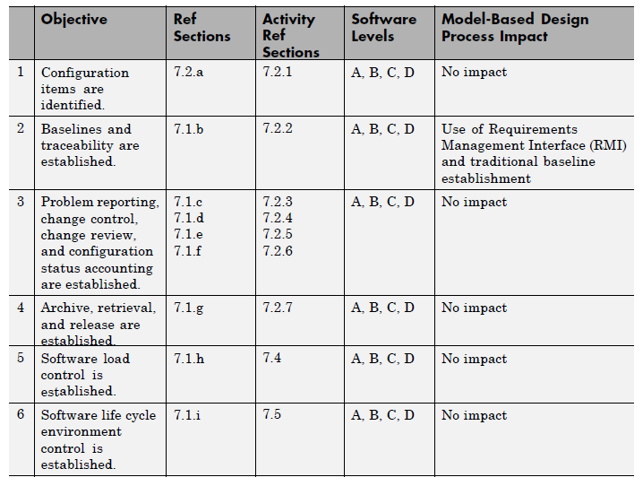
Software Configuration Management Process
S9: Traceability reports
CM Integration
Dependency analysis
Tools:
Currently supported: Subversion, In development: GIT
Commercial tools being developed by respective vendors.

Slide 53
Overview of MathWorks Tool Chain R2012b Example of DO-178 Software life-cycle
xPC TargetTM
Simulink® CoderTM
Simulink®
Stateflow®
Simulink® Design VerifierTM
Requirements
Simulink®
Simulink® Design VerifierTM
Simulink® Validation
VerificationTM (RMI)
Stateflow®
Simulink® Validation VerificationTM (MC)
Embedded CoderTM (PIL)
SystemTestTM
Simulink® Report GeneratorTM (SDD)
Simulink® Validation
VerificationTM (MA)
Polyspace® ( RTE)
Models
Code coverage
Simulink® Code InspectorTM
Embedded CoderTM (PIL)
Embedded CoderTM
Simulink® Code InspectorTM
SystemTestTM
Polyspace® (MISRA, RTE)
Polyspace® ( RTE)
Validate
C code
Verify
Trace
Compile & Build
Abbreviations
DV: Simulink Design Verifier
MA: Model Advisor
MC: Model Coverage
RMI: Requirements Management Interface
RTE: Run-Time Error
PIL: Processor-in-the-Loop
SDD: System Design Description
VV: Verification and Validation
Develop
DO Qualification Kit
EOC

Slide 54
Process Deployment Advisory Services Quickly Adopt Model-Based Design for DO-178
Provides key ingredients necessary to accelerate transition towards DO-178 compatible processes and tool chains for Model-Based Design
Typical deployment service
Familiarization with existing processes and tools
Gap analysis
Targeted instruction
Hands-on deployment support
http://www.mathworks.com/services/consulting/areas/do-process-deployment.html

Slide 55
Close
Thank you!
Further information:
Phil Maltby – Account Manager (phil.maltby@mathworks.com)

